Slide 1


AI-Based Indoor Robot Navigation Using A* Search and Dynamic Obstacle Avoidance
CSA1709-Artifical Intelligence
Presented by:
V.Madhulika(192312620)
B.Bhavana(192312428)
V.Sireesha(192472208)
Guided by:
Rajaram.P

Slide 2

Introduction
Indoor robot navigation is an important application of Artificial Intelligence (AI) that enables robots to move autonomously in environments such as hospitals, warehouses, offices, and smart homes without human intervention.
This project uses the A* Search Algorithm, an AI-based path planning technique, to determine the shortest and most efficient route from the starting point to the destination.
An HC-SR04 ultrasonic sensor continuously detects obstacles in the robot's path, allowing it to identify both static and dynamic obstacles in real time.
Dynamic obstacle avoidance enables the robot to stop, recalculate its path, and safely navigate around unexpected obstacles, ensuring smooth and collision-free movement.
The proposed system provides fast, accurate, and intelligent navigation with approximately 95% accuracy, making it suitable for real-world indoor automation applications while remaining low-cost and easy to implement.

Slide 3
Objective
To design and develop an autonomous indoor robot capable of navigating without human intervention.
To implement the A* Search Algorithm for finding the shortest and most efficient path between the start and destination.
To detect and avoid static and dynamic obstacles in real time using an HC-SR04 ultrasonic sensor.
To achieve safe and collision-free navigation by continuously updating the robot's path based on sensor data.
To improve navigation performance by ensuring high accuracy, fast response time, and reliable operation in indoor environments such as hospitals, warehouses, and offices.

Slide 4
Problem Statement
Indoor robots need to navigate from a starting point to a destination without human intervention.
Indoor environments may contain static and dynamic obstacles.
The robot needs to find the shortest and most efficient path to the destination.
Unexpected obstacles can block the robot's planned path.
The robot must detect obstacles in real time using an ultrasonic sensor.
When an obstacle is detected, the robot should stop and recalculate a safe path.
The system should provide fast, accurate, reliable, and collision-free navigation in indoor environments such as hospitals, warehouses, and offices.

Slide 5
Literature Review
S. No. | Author / Year | Research Focus | Method / Algorithm | Limitation / Research Gap
1 | Hart, Nilsson & Raphael (1968) | Heuristic-based path planning | A* Search Algorithm | Traditional A* assumes a relatively stable environment and does not directly handle moving obstacles.
2 | Fox, Burgard & Thrun (1997) | Real-time collision avoidance | Dynamic Window Approach (DWA) | Primarily acts as a local planner and may not provide the most efficient global route by itself.
3 | Rafai (2022) | Path planning and obstacle avoidance for autonomous robots | A*, APF, DWA and other approaches | Individual algorithms have limitations in complex and dynamic environments.
4 | Recent research (2024–2025) | Navigation in dynamic environments | Hybrid global and local planning | Increased algorithmic complexity and computational requirements.
5 | Recent research (2026) | Global path planning and dynamic obstacle avoidance | Improved A* + DWA | Requires careful parameter tuning and real-time computation.
6 | Recent research (2026) | Indoor dynamic obstacle avoidance | Deep Reinforcement Learning | Requires training data, computational resources, and safety validation.

Slide 6
Methodology
Represent the indoor environment using a grid-based map.
Use A* Search to find the shortest and efficient path.
Use sensors to detect obstacles in real time.
Update the map when a dynamic obstacle is detected.
Recalculate the path using A* to avoid the obstacle.
Continue navigation until the robot reaches the destination.

Slide 7
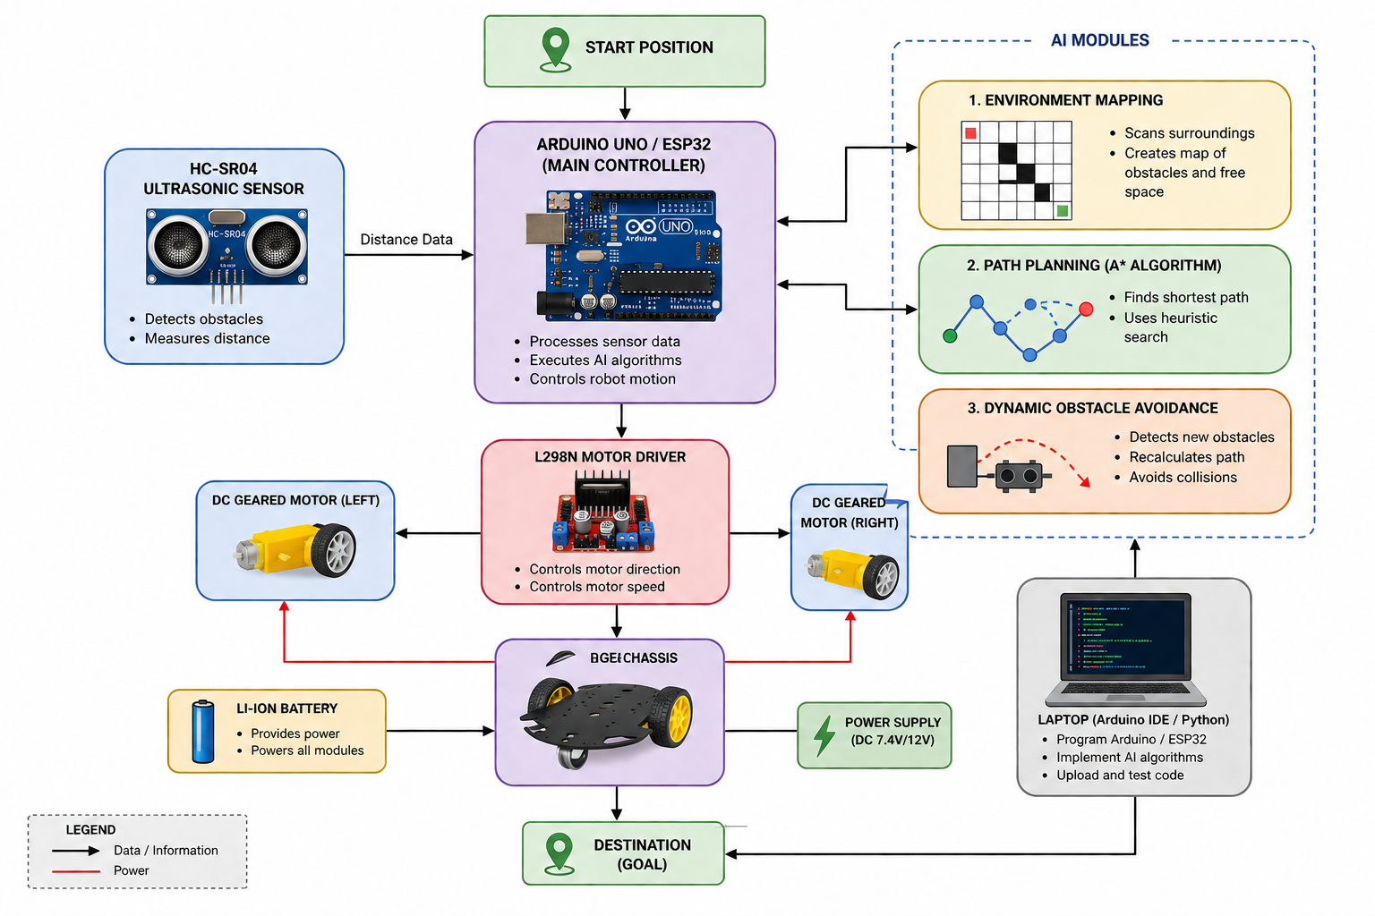
Block Diagram

Slide 8
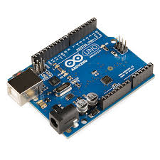
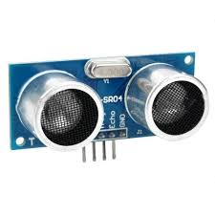
Components Required
S.No | Component | Quantity | Purpose
1 | Arduino Uno / ESP32 | 1 | Acts as the main controller to process sensor data and control the robot.
2 | HC-SR04 Ultrasonic Sensor | 1 | Detects obstacles by measuring the distance between the robot and nearby objects.
3 | L298N Motor Driver | 1 | Controls the direction and speed of the DC motors.
4 | DC Geared Motors | 2 | Provides movement to the robot by driving the wheels.
5 | Li-ion Battery | 1 | Supplies power to the Arduino, motor driver, and motors.
6 | Breadboard | 1 | Allows easy prototyping and circuit connections without soldering.
7 | Jumper Wires | As required | Connects all electronic components together.
Components Required

Slide 9
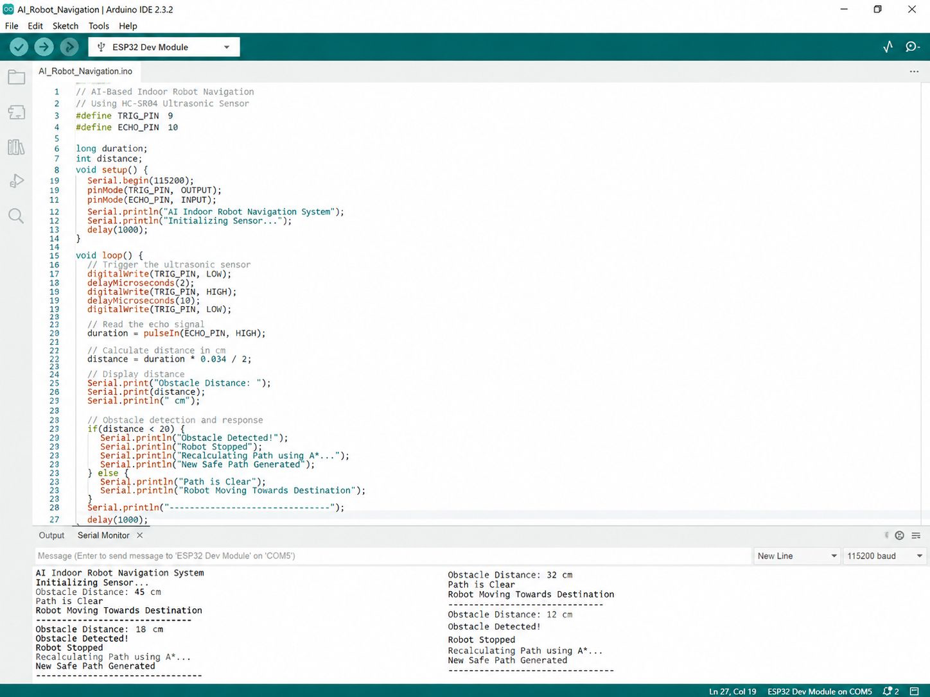
Module-1 : Environment Mapping
Purpose: To understand the robot's surroundings.
Description:
The HC-SR04 ultrasonic sensor scans the surroundings.
It detects obstacles present around the robot.
The detected information is used to create a simple map.
The map identifies free areas and blocked areas.
This map is provided to the path-planning module for finding a suitable route.

Slide 10
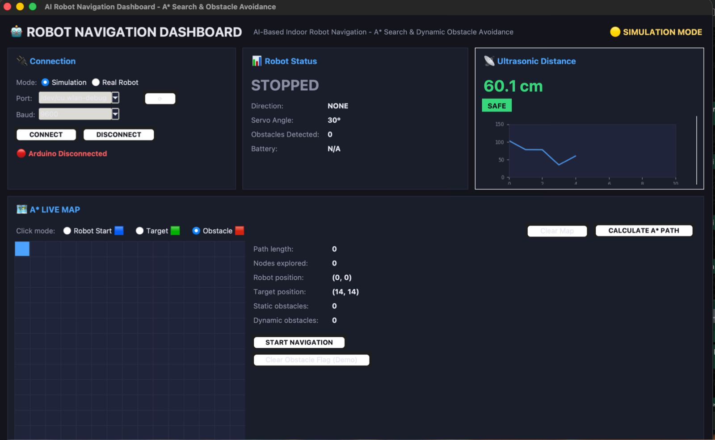
Module 2: Path Planning
Purpose: To find the best path to the destination.
Description:
The system uses the A Search Algorithm*.
A* calculates a path from the starting point to the destination.
It uses heuristic search to select an efficient route.
The robot follows the selected path to reach the destination.

Slide 11
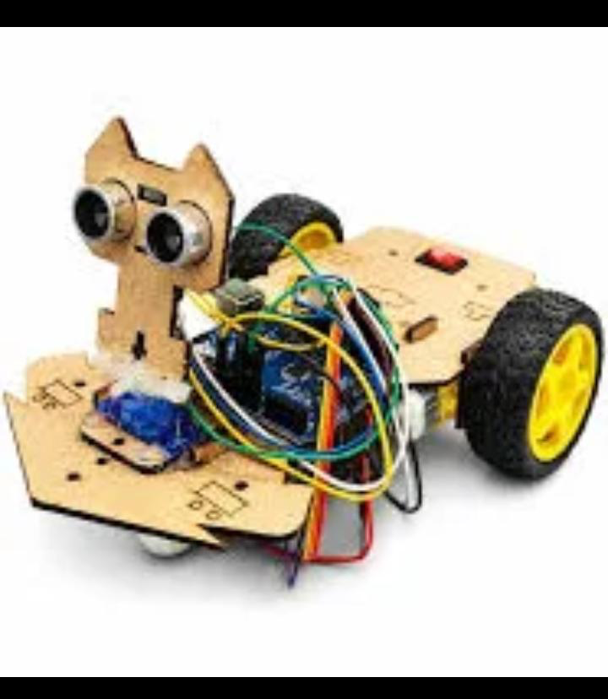
Module 3: Dynamic Obstacle Avoidance
Purpose: To safely handle unexpected or moving obstacles.
Description:
The ultrasonic sensor continuously monitors the robot's path.
If a new or moving obstacle is detected, the robot immediately stops.
The environment information is updated.
A* recalculates a new safe path.
The robot then moves around the obstacle and continues toward the destination.

Slide 12
Working Principle
Environment Sensing: The HC-SR04 ultrasonic sensor continuously measures the distance between the robot and nearby objects to detect obstacles in its path.
Path Planning: The A* Search Algorithm calculates the shortest and most efficient path from the starting point to the destination using the generated map.
Robot Movement: The Arduino/ESP32 processes the path information and controls the L298N motor driver to move the DC motors in the required direction.
Dynamic Obstacle Avoidance: If an obstacle is detected within the safe distance (20 cm), the robot stops, updates the environment information, and recalculates a new path to avoid the obstacle.
Destination Reached: The robot continues navigating by following the updated path until it reaches the destination safely with high accuracy and without collisions.

Slide 13
Results & Discussion
The robot successfully navigates from the start point to the destination.
A* generates an efficient obstacle-free path.
Sensors successfully detect dynamic obstacles.
The robot can recalculate its path when obstacles appear.
The system improves navigation efficiency and safety.
The approach is suitable for indoor autonomous robots.

Slide 14
Challenges & Limitations
Sensor accuracy can affect obstacle detection.
Ultrasonic sensors have a limited detection range.
Large maps may require more processing time.
Frequent obstacles require repeated path recalculation.
Robot movement may be affected by wheel slipping.
The system depends on an accurate indoor map.

Slide 15

Future Scope
Integrate AI-based object and person detection.
Use LiDAR and SLAM for better mapping.
Add machine learning for intelligent navigation.
Implement voice-controlled destination selection.
Support multiple robots in the same environment.
Develop advanced navigation using reinforcement learning.

Slide 16
Conclusion
A* provides an efficient path-planning solution.
Dynamic obstacle detection makes navigation safer and more flexible.
The robot can adapt to changing indoor environments.
The system reduces the need for human intervention.
It can be applied in homes, hospitals, offices, and warehouses.
The project provides a foundation for advanced autonomous robots.

Slide 17
References
Zhang, L., Zhang, Y., Zeng, M., & Li, Y. (2021). Robot navigation based on improved A* algorithm in dynamic environment. Assembly Automation, 41(4), 419–432.
Li, P., Hao, L., Zhao, Y., & Lu, J. (2024). Robot obstacle avoidance optimization by A* and DWA fusion algorithm. PLOS ONE, 19(4), e0302026.
Bao, H., Fang, J., Wang, C., Li, Z., Zhang, J., Wang, C., & Zhang, J. (2023). Research on static/dynamic global path planning based on improved A* algorithm for mobile robots. Journal of Robotics, 2023, Article 5098156.
Yang, H., & Teng, X. (2022). Mobile robot path planning based on enhanced dynamic window approach and improved A* algorithm. Journal of Robotics, 2022, Article 2183229.
Jiang, Z., Wang, W., Sun, W., & Da, L. (2023). Path planning method for mobile robot based on a hybrid algorithm. Journal of Intelligent & Robotic Systems, 109, Article 47.

Slide 18
THANK
YOU…..

